Slide 1
ASBC Update
November 7, 2013
Golden, Colorado

Slide 2
Exciting News
Membership Changes
Meeting in a Box
Craft Brewers Conference
Update from the Technical Committee

Slide 3
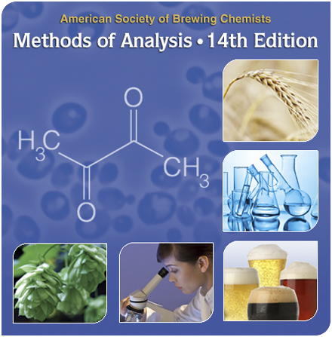
Membership Changes
New membership package:
  Single user Methods of Analysis (MOA)
  Quarterly live webinars
  And more!

Slide 4

Meeting in a Box
An all-encompassing meeting
Look for the first “MIB” to take place January 29th, 2014 at Avery Brewing Company in Boulder, CO.
Topic: Yeast

Slide 5

Craft Brewers Conference
ASBC will be at
BrewExpo America®
Presenting on the Science
of Beer in conjunction with
the Brewers Association

Slide 6
ASBC Technical Committee Update
Currently supporting 16 subcommittees & standing committees
  Adding value
  Further developing the Methods of Analysis.
Looking for volunteers for a short collaborative study to measure VDK in beer by gas chromatography/electron capture detection
  Contact Grant Ruehle at New Belgium (gruehle@newbelgium.com) if you are interested

Slide 7
Thank you!

